Slide 1


方案读取中，请稍等……
请耐心等待自动播放……

Slide 2
我们的目的
Fast science development
现代战争武器装备高速发展
无人武器成为重要研究对象
Important area

Slide 3
Why we do this
无人武器成为重要研究对象
Fast science development
协同作战指挥人才将主导战场
Talents person with leadership

Slide 4
协同作战指挥人才将主导战场
Talents person with leadership
Our target

Slide 5
《PPT动画传奇》附赠动画库，限读者学习交流，请勿销售。本书宣传片下载：http://www.rapidbbs.cn/forum.php?mod=forumdisplay&fid=109
机器人模拟战场
选自锐普PPT论坛十驾斋：http://www.rapidbbs.cn/forum.php?mod=viewthread&tid=32280

Slide 6

实现无人自主战斗，适应科技发展趋势
体现协同作战，锻炼指挥能力
机器人可随时更新，符合战场装备高速发展形势
Notes:
Animated captions move and change color over Seattle cityscape
(Intermediate)
To reproduce the picture on this slide, do the following:
On the Home tab, in the Slides group, click Layout, and then click Blank.
On the Insert tab, in the Illustrations group, click Picture. In the Insert Picture dialog box, select a picture, and then click Insert.
Under Picture Tools, on the Format tab, in the Size group, click the Size and Position dialog box launcher. In the Format Picture dialog box, resize or crop the image so that the height is set to 3” and the width is set to 10”. To crop the picture, click Crop in the left pane, and in the right pane, under Crop position, enter values into the Height, Width, Left, and Top boxes. To resize the picture, click Size in the left pane, and in the right pane, under Size and rotate, enter values into the Height and Width boxes.
Select the picture. On the Home tab, in the Drawing group, click the arrow under Arrange, point to Align, and do the following:
Click Align to Slide.
Click Align Center.
Click Align Top.
To reproduce the text effects on this slide, do the following:
On the Insert tab, in the Text group, click Text Box, and then on the slide, drag to draw the text box.
Enter text in the text box, and then select the text. On the Home tab, in the Font group, select Century Gothic from the Font list, select 30 pt. from the Font Size list, and then click Bold.
Click the arrow next to Font Color, click More Colors, and then in the Colors dialog box, on the Custom tab, enter values for Red: 80, Green: 129, Blue: 226.
On the Home tab, in the Paragraph group, click Align Text Left to align the text left in the text box.
Drag the text box below the picture, in the middle of the left side of the slide.
To reproduce the animation effects for the first text box on this slide, do the following:
On the slide, select the text box. On the Animations tab, in the Advanced Animation group, click Add Animation, and then under Entrance click Fade.
On the Animations tab, in the Timing group, in the Start list, select With Previous.
On the Animations tab, in the Timing group, in the Duration box, enter 2.
On the slide, select the text box. On the Animations tab, in the Advanced Animation group, click Add Animation, and then under Motion Paths click Lines.
On the Animations tab, in the Timing group, in the Start list, select With Previous.
On the Animations tab, in the Timing group, in the Duration box, enter 2.
On the Animations tab, in the Animation group, click Effect Options, and then click Left.
On the slide, select the motion path for the text box. Point to the endpoint (red arrow) until the cursor becomes a two-headed arrow, press and hold SHIFT, and then drag the endpoint to lengthen the motion path about 4”. (Note: It will help to use the ruler to measure the path. On the View tab, in the Show/Hide group, select Ruler.)
On the slide, select the text box. On the Animations tab, in the Advanced Animation group, click Add Animation, and then under Emphasis click Font Color.
On the Animations tab, in the Timing group, in the Start list, select After Previous.
On the Animations tab, in the Timing group, in the Duration box, enter 1.
On the Animations tab, in the Animation group, click Effect Options, and then click White.
To reproduce the other animated text boxes on this slide, do the following:
On the slide, select the text box. On the Home tab, in the Clipboard group, click the arrow next to Copy, and then click Duplicate. Drag the second text box below and to the right of the first text box.
Click in the second text box, and then edit the text.
Select the text in the second text box. On the Home tab, in the Font group, select 24 pt, click Bold to unbold the text, and then click Italic.
On the slide, select the motion path for the second text box. Point to the starting point (green arrow) until the cursor becomes a two-headed arrow. Press and hold SHIFT, and then drag the starting point to the left of the second text box, until the length of the path is about 4”.
Select the first text box. On the Home tab, in the Clipboard group, click the arrow next to Copy, and then click Duplicate.
On the slide, drag the third text box until it is below and to the left of the second text box, and to the right of the first text box.
Click in the third text box, and then edit the text.
Select the text in the third text box. On the Home tab, in the Font group, select 24 pt.
On the slide, press and hold CTRL, and then select all three text boxes. In the Custom Animation task pane, do the following:
On the Animations tab, in the Advanced Animation group, click Add Animation, and then under Emphasis, click Grow/Shrink.
On the Animations tab, in the Timing group, in the Start list, select With Previous.
On the Animations tab, in the Timing group, in the Duration box, enter 2.
On the Animations tab, in the Animation group, click Effect Options, click Horizontal, and then click Larger.
On the Animations tab, in the Advanced Animation group, click Add Animation, and then under Exit click Fade.
On the Animations tab, in the Timing group, in the Start list, select With Previous.
On the Animations tab, in the Timing group, in the Duration box, enter 2.
On the Animations tab, in the Advanced Animation group, click Animation Pane. In the Animation Pane, press and hold CTRL and select the 10th and 11th animation effects (grow and fade effects for the first text box), and then, on the Animations tab, in the Timing group, click Move Earlier.
De-select the animation effects.
Also in the Animation Pane, press and hold CTRL and select the 14th and 15th animation effects (grow and fade effects for the third text box), and then, on the Animations tab, in the Timing group, in the Start list, select After Previous.
To reproduce the background effects on this slide, do the following:
On the Design tab, in the Background group, click Background Styles, and then click Format Background. In the Format Background dialog box, click Fill in the left pane, select Gradient fill in the Fill pane, and then do the following:
In the Type list, select Linear.
In the Angle box, enter 90.
Under Gradient stops, click Add gradient stops or Remove gradient stops until four stops appear in the slider.
Also under Gradient stops, customize the gradient stops as follows:
Select the first stop in the slider, and then do the following:
In the Position box, enter 0%.
Click the button next to Color, and then under Theme Colors click Black, Text 1, Lighter 25% (fourth row, second option from the left).
Select the next stop in the slider, and then do the following:
In the Position box, enter 20%.
Click the button next to Color, and then under Theme Colors click Black, Text 1 (first row, second option from the left).
Select the next stop in the slider, and then do the following:
In the Position box, enter 80%.
Click the button next to Color, and then under Theme Colors click Black, Text 1 (first row, second option from the left).
Select the next stop in the slider, and then do the following:
In the Position box, enter 100%.
Click the button next to Color, and then under Theme Colors click Black, Text 1, Lighter 25% (fourth row, second option from the left).

Slide 7
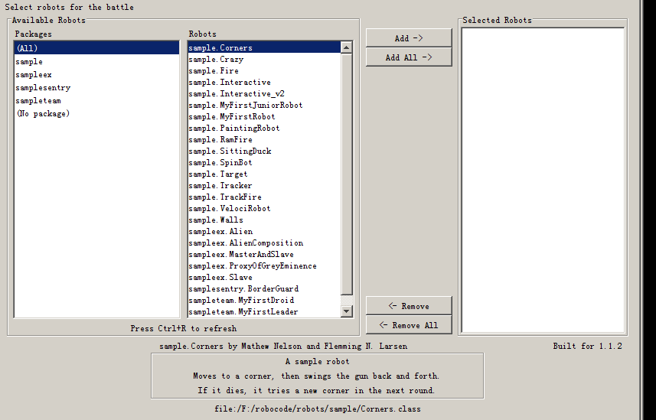
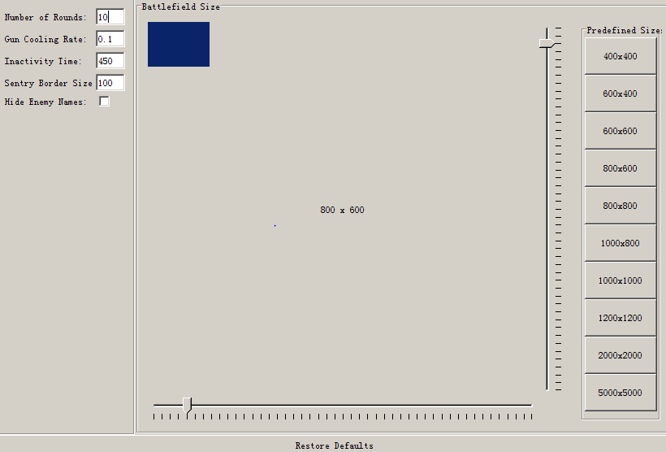
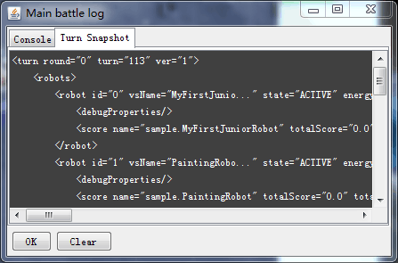
机器人载入
战场环境与规则设置
战斗快照功能

Slide 8
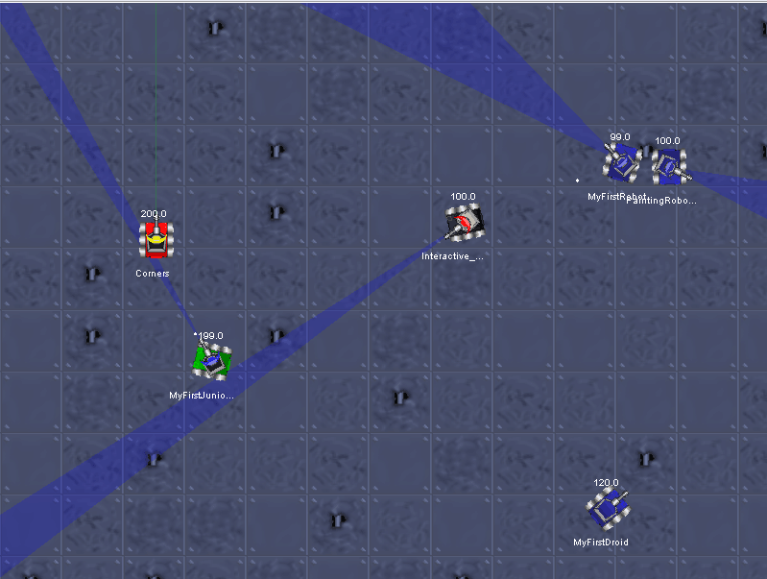
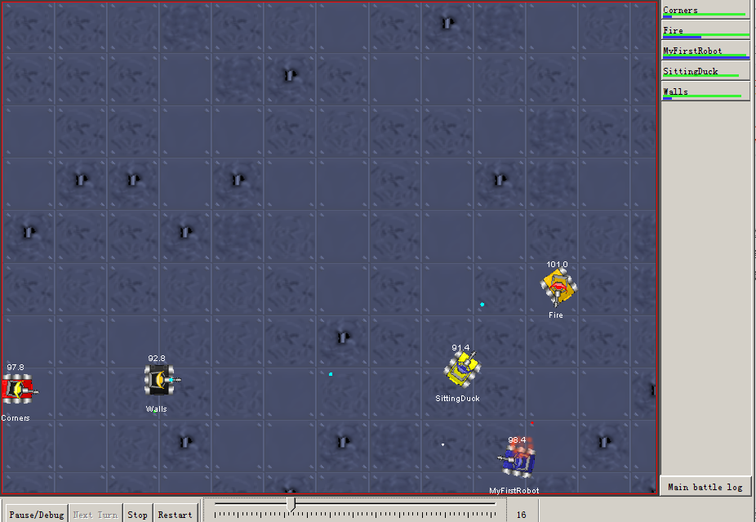
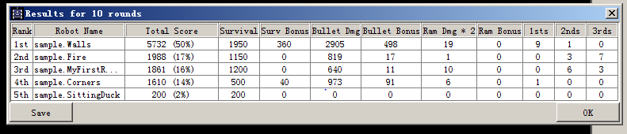
战斗环境模拟
战斗结果显示分析
雷达扫描线功能

Slide 9
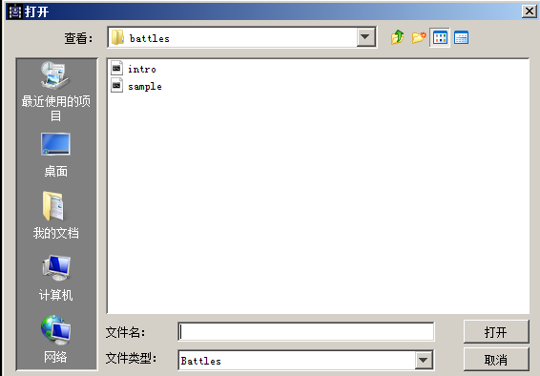
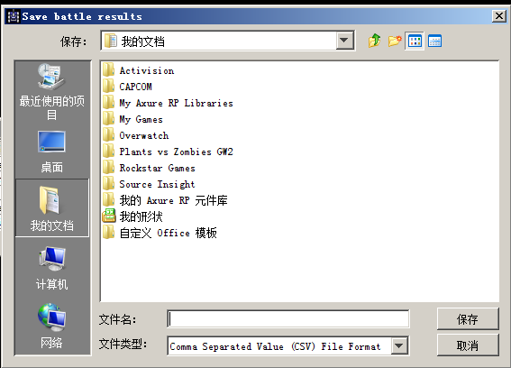
战斗重载
战斗数据保存

Slide 10
你是否想要体会运筹帷幄决胜千里之外
你是否想要层层优化破解敌方先进武器
你是否想要提升自己协同作战的技能

Slide 11
《PPT动画传奇》附赠动画库，限读者学习交流，请勿销售。本书宣传片下载：http://www.rapidbbs.cn/forum.php?mod=forumdisplay&fid=109
LET’S THE BATTLE BEGIN!
Notes:
Animated text stretching up to enter
(Basic)
To reproduce the rectangle on this slide, do the following:
On the Home tab, in the Slides group, click Layout, and then click Blank.
On the Home tab, in the Drawing group, click Shapes, and then under Rectangles click Rectangle (first option from the left). On the slide, drag to draw a rectangle.
Select the rectangle. Under Drawing Tools, on the Format tab, in the Size group, do the following:
In the Shape Height box, enter 3”.
In the Shape Width box, enter 10”.
With the rectangle still selected, on the Home tab, in the Drawing group, do the following:
Click the arrow next to Shape Fill, and then under Theme Colors click Black, Text 1, Lighter 5% (fifth row, second option from the left).
Click the arrow next to Shape Outline, and then click No Outline.
On the Home tab, in the Drawing group, click Arrange, point to Align, and then do the following:
Click Align to Slide.
Click Align Top.
Click Align Center.
To reproduce the text on this slide, do the following:
On the Insert tab, in the Text group, click Text Box, and then on the slide, drag to draw a text box.
Enter text in the text box and select the text. On the Home tab, in the Font group, do the following:
In the Font list, select Arial Black.
In the Font Size box, enter 38.
Click Bold.
On the Home tab, in the Paragraph group, click Center to center the text in the text box.
Select the text box. Under Drawing Tools, on the Format tab, in the bottom right corner of the WordArt Styles group, click the Format Text Effects dialog box launcher. In the Format Text Effects dialog box, click Text Fill in the left pane, select Gradient fill the Text Fill, and then do the following:
In the Type list, select Linear.
Click the button next to Direction, and then click Linear Down (first row, second option from the left).
in the drop-down list.
Under Gradient stops, click Add or Remove until three stops appear on the slider, then customize the gradient stops as follows:
Select Stop 1 on the slider, and then do the following:
In the Position box, enter 0%.
Click the button next to Color, click More Colors, and then in the Colors dialog box, on the Custom tab, enter values for Red: 255, Green: 214, Blue: 63.
Select Stop 2 on the slider, and then do the following:
In the Position box, enter 75%.
Click the button next to Color, click More Colors, and then in the Colors dialog box, on the Custom tab, enter values for Red: 255, Green: 192, Blue: 0.
Select Stop 3 on the slider, and then do the following:
In the Position box, enter 100%.
Click the button next to Color, click More Colors, and then in the Colors dialog box, on the Custom tab, enter values for Red: 255, Green: 162, Blue: 96.
Also in the Format Text Effects dialog box, click Shadow in the left pane. In the Shadow pane, click the button next to Presets, under Outer click Offset Bottom (first row, second option from the left), and then do the following:
In the Transparency box, enter 70%.
In the Size box, enter 100%.
In the Blur box, enter 6.3 pt.
In the Angle box, enter 84°.
In the Distance box, enter 3.2 pt.
Also in the Format Text Effects dialog box, click 3-D Format in the left pane, and then do the following in the 3-D Format pane:
Under Bevel, click the button next to Top, and then under Bevel click Circle (first row, first option from the left). Next to Top, in the Width box, enter 2 pt, and in the Height box, enter 2 pt.
Under Contour, click the button next to Color, click More Colors, and then in the Colors dialog box, on the Custom tab, enter values for Red: 215, Green: 130, Blue: 60. In the Size box, enter 1 pt.
Under Surface, in the Material list, under Standard, select Warm Matte (second option from the left). In the Lighting list, under Special, select Glow (third option from the left). In the Angle box, enter 90°.
On the slide, drag the text box just above the bottom edge of the rectangle.
On the Home tab, in the Drawing group, click Arrange, point to Align, and then do the following:
Click Align to Slide.
Click Align Center.
To reproduce the line on this slide, do the following:
On the Home tab, in the Drawing group, click Shapes, and then under Lines click Line (first option from the left). On the slide, press and hold SHIFT, and then drag to draw a straight, horizontal line.
Select the line. Under Drawing Tools , on the Format tab, in the Size group, in the Shape Width box, enter 10”.
Under Drawing Tools, on the Format tab, in the bottom right corner of the Shape Styles group, click the Format Shape dialog box launcher. In the Format Shape dialog box, click Line Color in the left pane. In the Line Color pane, select Solid line, click the button next to Color, and then select More Colors. In the Colors dialog box, on the Custom tab, enter Red: 255, Green: 232, Blue: 63.
Also in the Format Shape dialog box, click Line Style in the left pane. In the Line Style pane, in the Width box, enter 4.5 pt.
Also in the Format Shape dialog box, click 3-D Format in the left pane. In the 3-D Format pane, under Bevel, do the following:
Click the button next to Top, and then under Bevel click Circle (first row, first option from the left).
Next to Top, in the Width box, enter 3 pt.
Next to Top, in the Height box, enter 6 pt.
On the slide, drag the line until the top edge touches the bottom edge of the rectangle.
On the Home tab, in the Drawing group, click Arrange, point to Align, and then do the following:
Click Align to Slide.
Click Align Center.
To reproduce the animation effects on this slide, do the following:
On the slide, select the text box. On the Animations tab, in the Animation group, click the More arrow on the Animation Effects gallery, then under Exit, click Disappear.
In the Timing group, in the Start list, select After Previous.
In the Advanced Animations group, click Animation Pane. Select the second animation effect (grow/shrink effect for the text box). Click the arrow to the right of the effect, and then click Effect Options. In the Grow/Shrink dialog box, do the following:
On the Effect tab, in the Size list, in the Custom box, enter 400%, and then press ENTER. Also in the Size list, click Vertical.
On the Timing tab, do the following:
In the Start list, select After Previous.
In the Speed box, enter 0.01 seconds.
On the slide, select the text box. In the Advanced Animation group, click Add Animation, and under Entrance, click Appear.
In the Timing group, in the Start list, select After Previous.
On the slide, select the text box. In the Advanced Animation group, click Add Animation, and under Emphasis, click Grow/Shrink.
In the Animation Pane, select the fourth animation effect (grow/shrink effect for the text box). Click the arrow to the right of the effect, and then click Effect Options. In the Grow/Shrink dialog box, do the following:
On the Effect tab, in the Size list, select Tiny (25%). Also in the Size list, click Vertical.
On the Timing tab, do the following:
In the Start list, select With Previous.
In the Speed list, select 1 seconds (Fast).
On the slide, select the text box. In the Advanced Animation group, click Add Animation, then click More Entrance Effects. In the Add Entrance Effect dialog box, under Emphasis, click Rise Up.
In the Timing group, in the Start list, select With Previous. In the Speed list, select 01.00.
On the slide, press and hold CTRL, and then select the rectangle and the line. In the Advanced Animation group, click Add Effect, and then click More Effects. In the Add Entrance Effect dialog box, under Moderate, click Float Down.
Press and hold CTRL, and then select the sixth and seventh animation effects (descend effects for the rectangle and the line). In the Timing group, in the Start list, select With Previous. In the Speed list, select 01.00.
To reproduce the background effects on this slide, do the following:
Right-click the slide background area, and then click Format Background. In the Format Background dialog box, click Fill in the left pane, select Gradient fill in the Fill pane, and then do the following:
In the Type list, select Linear.
Click the button next to Direction, and then click Linear Up (second row, second option from the left).
Under Gradient stops, click Add or Remove until two stops appear on the slider, then customize the gradient stops as follows:
Select Stop 1 on the slider, and then do the following:
In the Position box, enter 0%.
Click the button next to Color, and then under Theme Colors click Black, Text 1, Lighter 15% (fifth row, second option from the left).
Select Stop 2 on the slider, and then do the following:
In the Position box, enter 100%.
Click the button next to Color, and then under Theme Colors click Black, Text 1, Lighter 50% (second row, second option from the left).

Slide 12

机器人模拟战场
小组：周浩、刘铭宇、李彦锋、郑鹏程、郭禹良
Made by Liang Shawn

